Slide 1
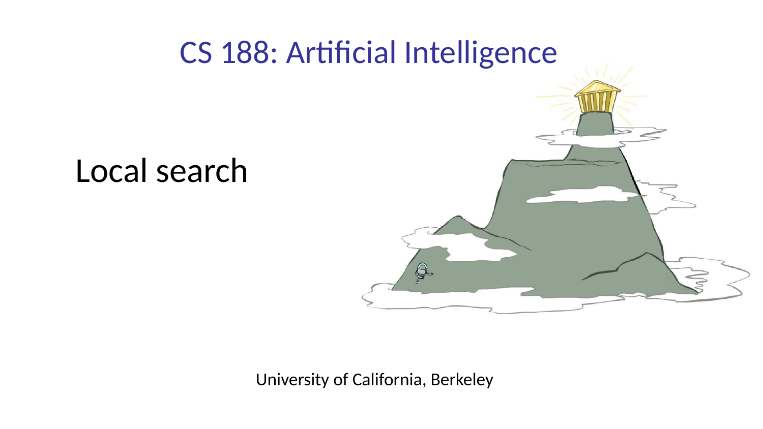
Local Search
01
Artificial Intelligence
Aesthetic refresh for COMP 469
COMP 469 • Artificial Intelligence • Local Search

Slide 2
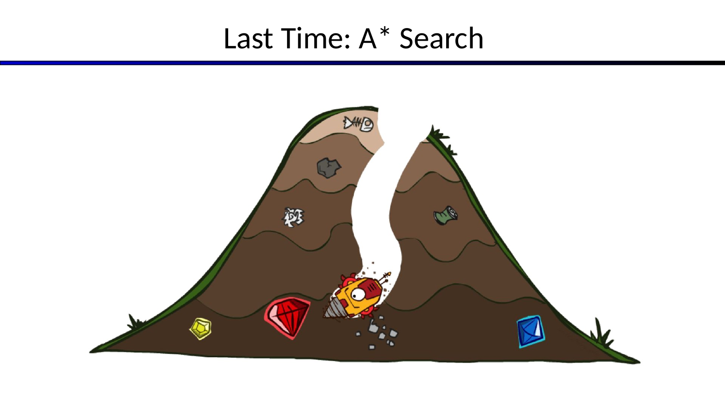
LOCAL SEARCH
Last Time: A* Search
Slide 02
COMP 469 • Artificial Intelligence • Local Search

Slide 3
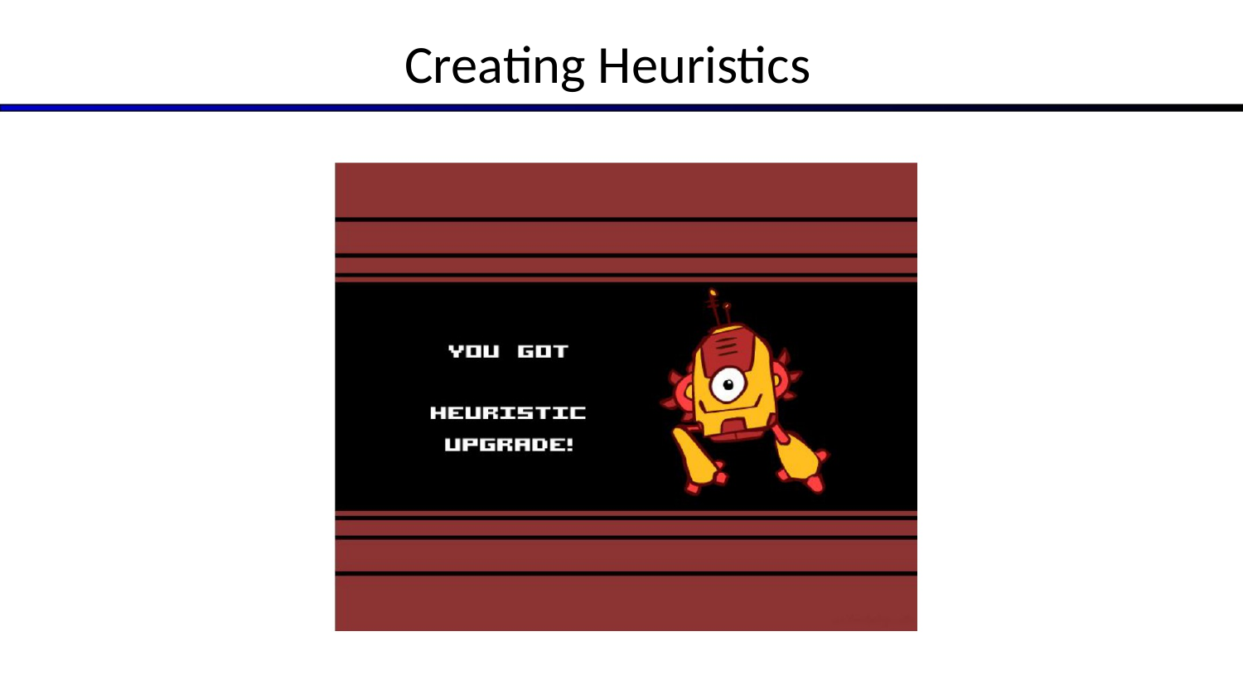
LOCAL SEARCH
Creating Heuristics
Slide 03
COMP 469 • Artificial Intelligence • Local Search

Slide 4
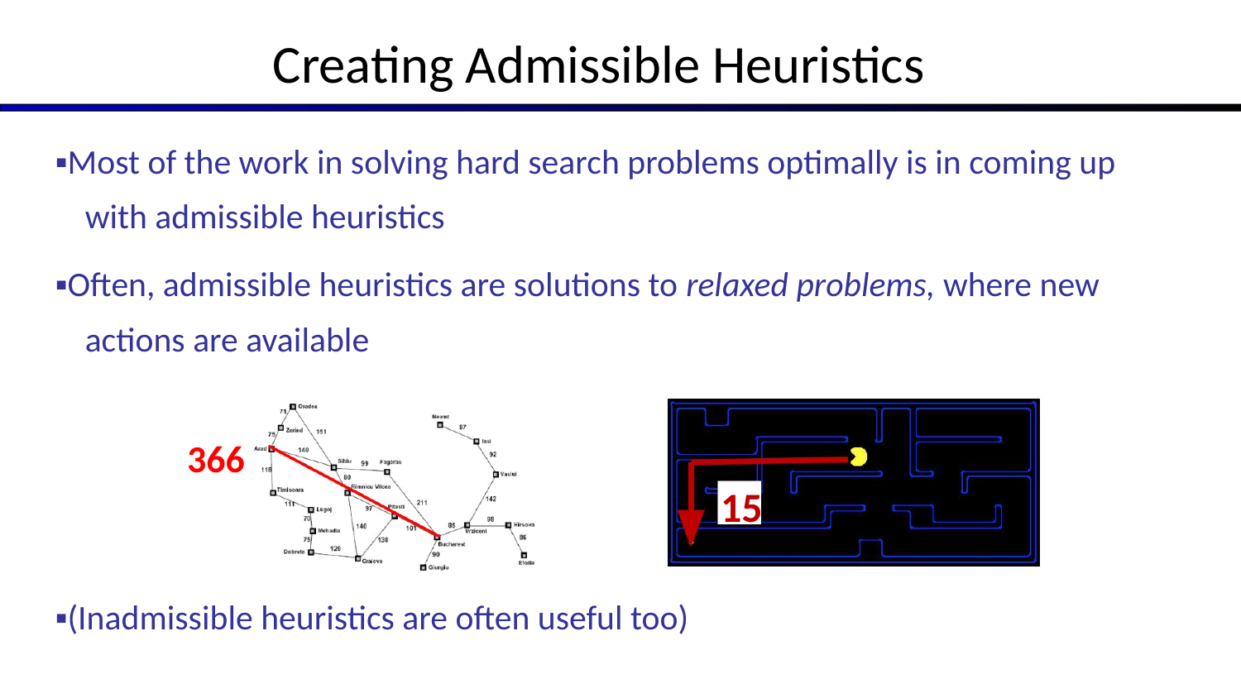
Creating Admissible Heuristics
04
Most of the work in solving hard search problems optimally is in coming up with admissible heuristics
Often, admissible heuristics are solutions to relaxed problems, where new actions are available
(Inadmissible heuristics are often useful too)
COMP 469 • Artificial Intelligence • Local Search

Slide 5
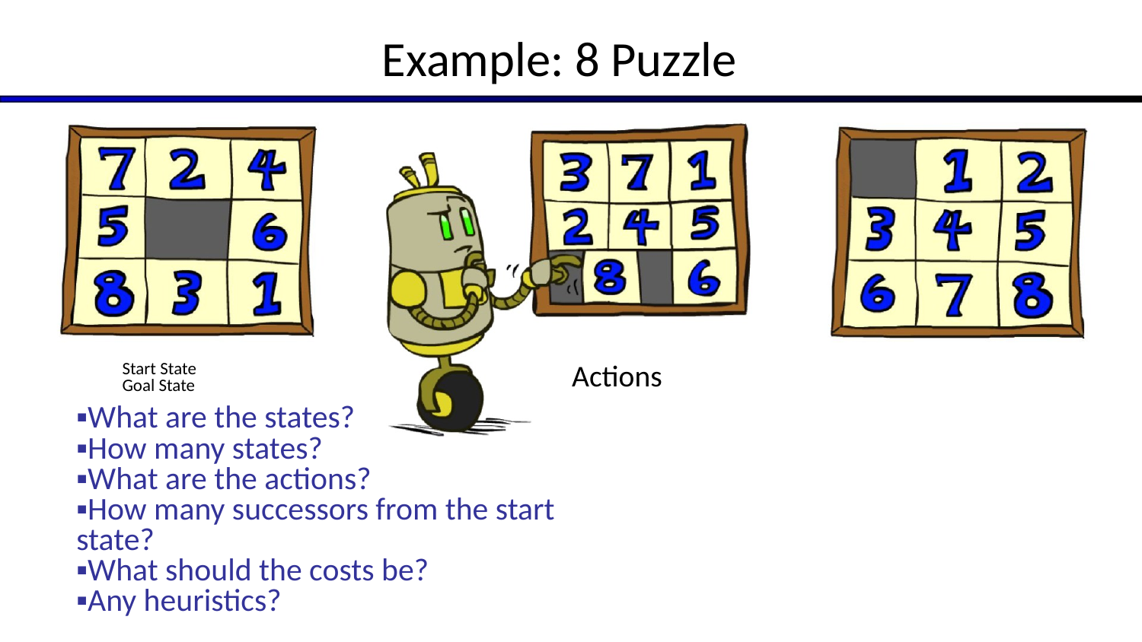
Example: 8 Puzzle
05
What are the states?
How many states?
What are the actions?
How many successors from the start state?
What should the costs be?
Any heuristics? Start State Goal State Actions
COMP 469 • Artificial Intelligence • Local Search

Slide 6
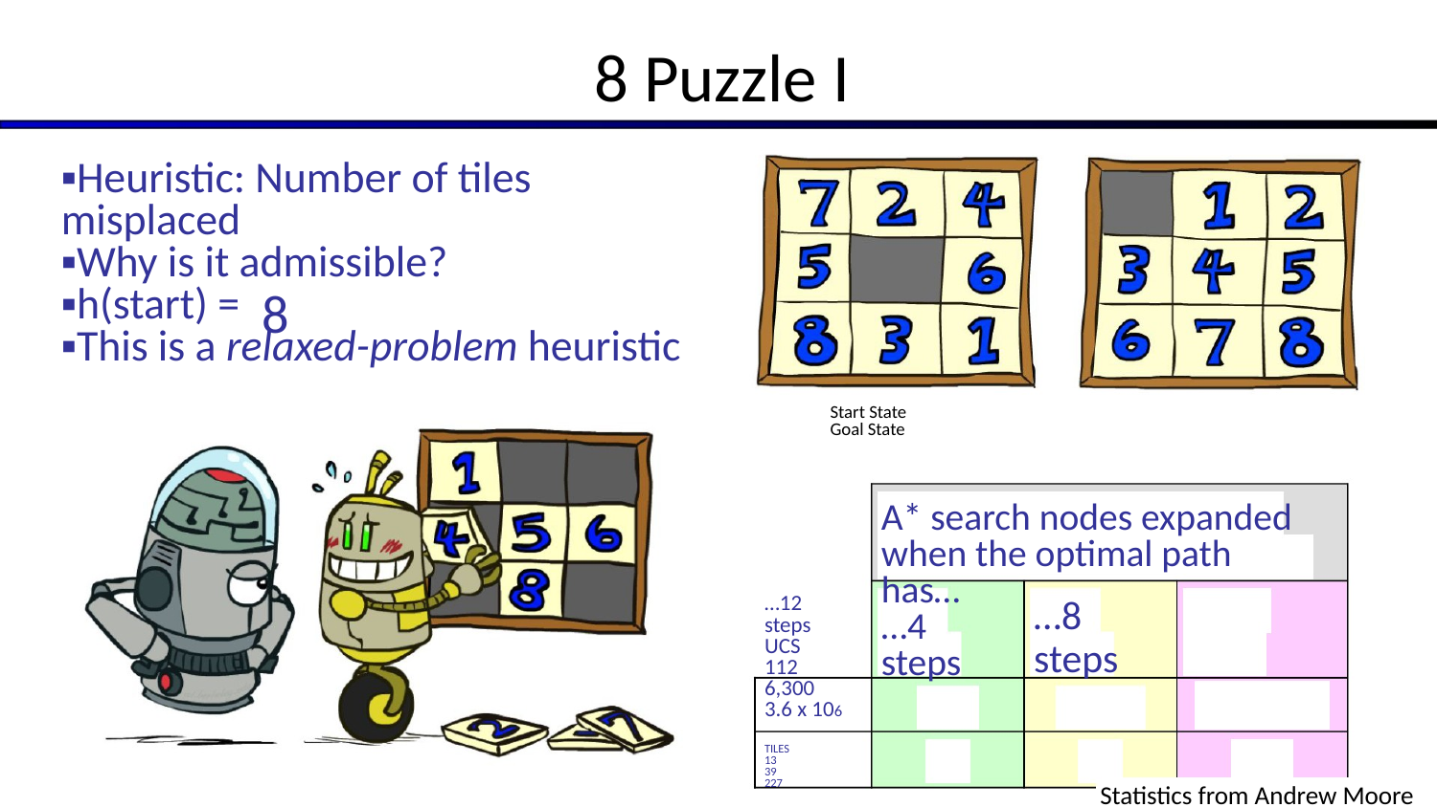
8 Puzzle I
06
Heuristic: Number of tiles misplaced
Why is it admissible?
h(start) =
This is a relaxed-problem heuristic A* search nodes expanded when the optimal path has… …4 steps …8 steps …12 steps UCS 6,300
3.6 x 106 TILES Start State Goal State Statistics from Andrew Moore
COMP 469 • Artificial Intelligence • Local Search

Slide 7
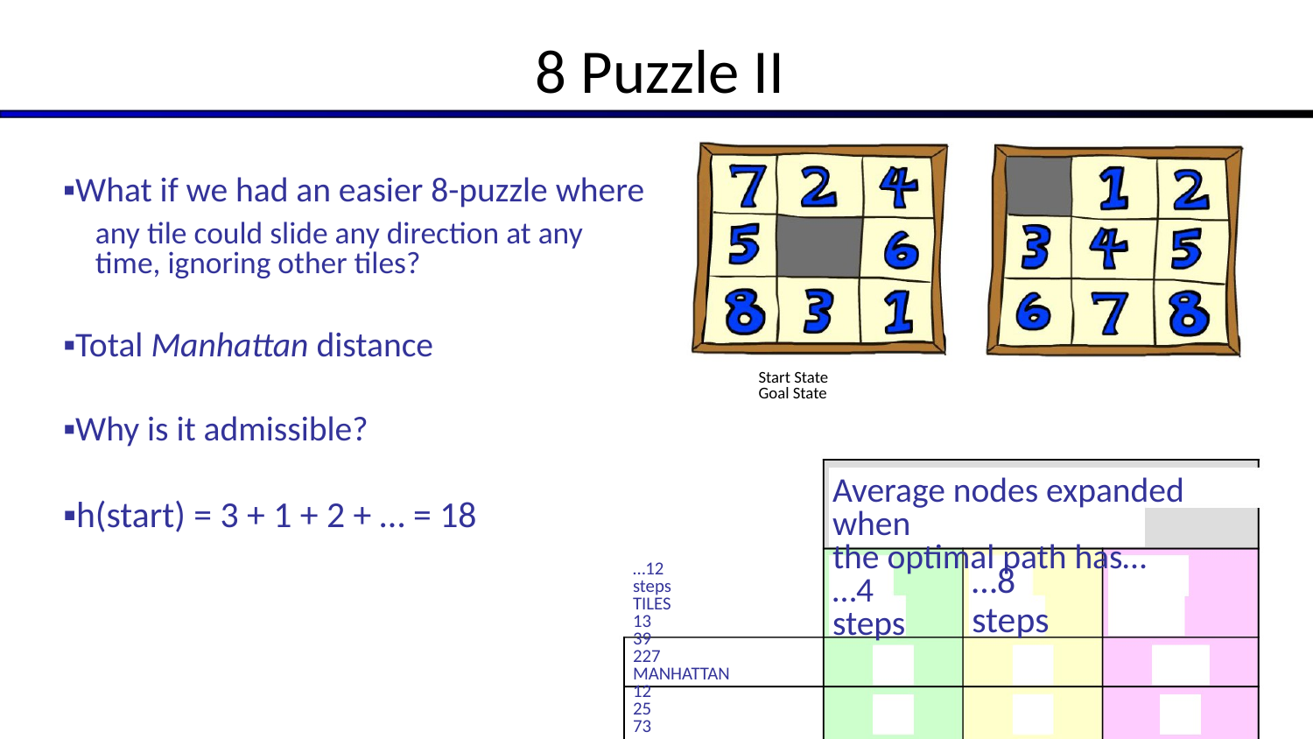
8 Puzzle II
07
What if we had an easier 8-puzzle where any tile could slide any direction at any time, ignoring other tiles?
Total Manhattan distance
Why is it admissible?
h(start) = 3 + 1 + 2 + … = 18 Average nodes expanded when the optimal path has… …4 steps …8 steps …12 steps TILES MANHATTAN Start State Goal State
COMP 469 • Artificial Intelligence • Local Search

Slide 8
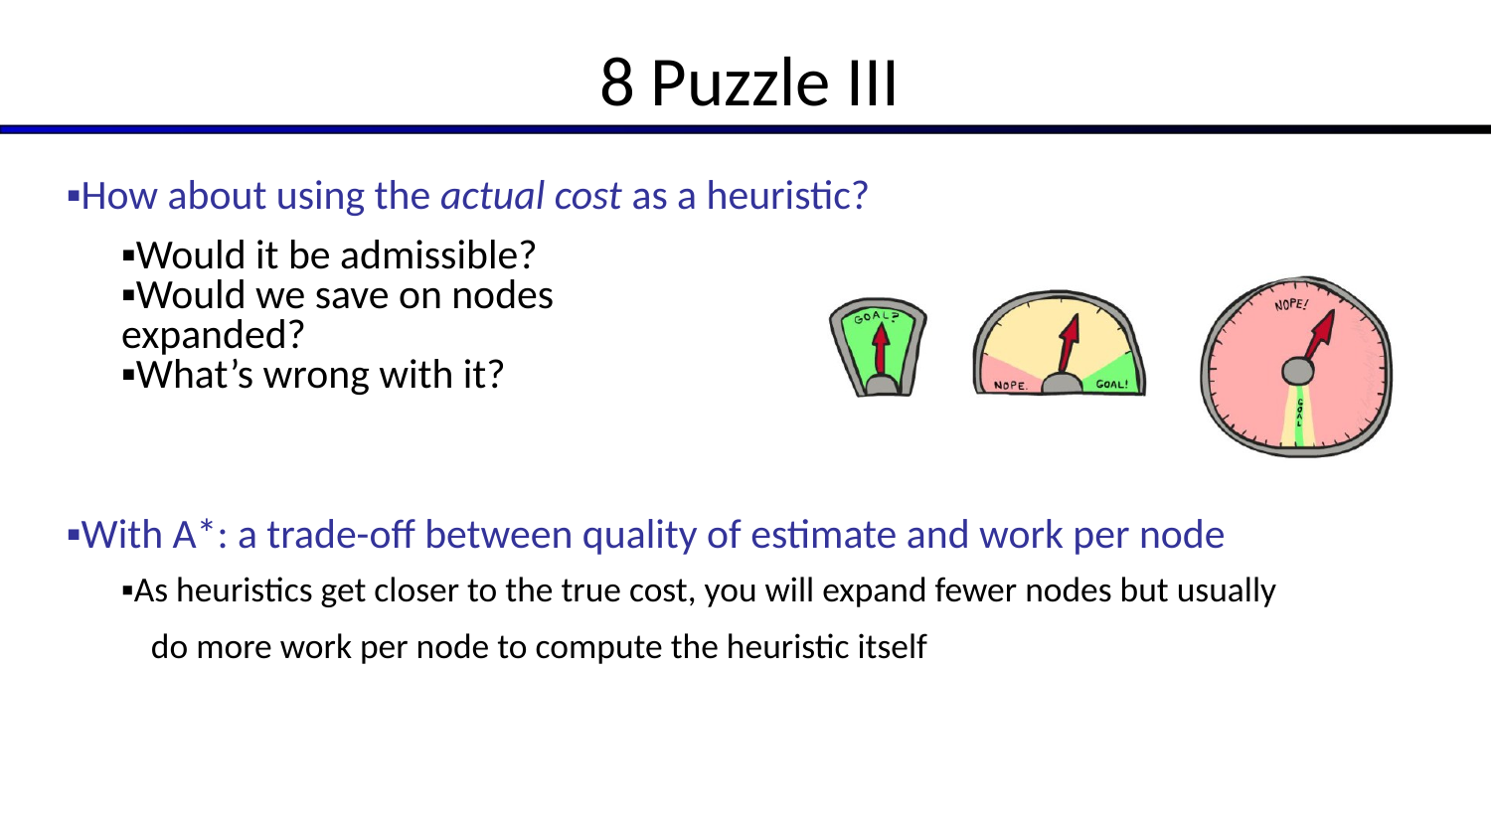
8 Puzzle III
08
How about using the actual cost as a heuristic?
Would it be admissible?
Would we save on nodes expanded?
What’s wrong with it?
With A*: a trade-off between quality of estimate and work per node
As heuristics get closer to the true cost, you will expand fewer nodes but usually do more work per node to compute the heuristic itself
COMP 469 • Artificial Intelligence • Local Search

Slide 9

LOCAL SEARCH
More Heuristic Properties
Slide 09
COMP 469 • Artificial Intelligence • Local Search

Slide 10
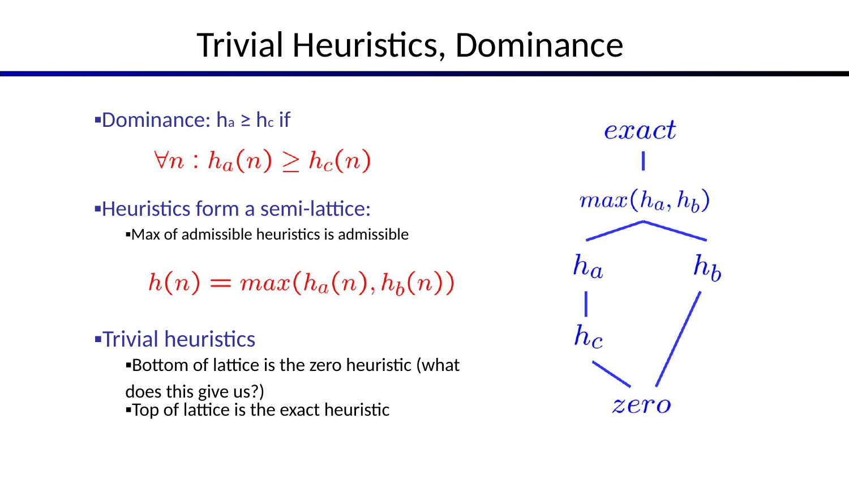
Trivial Heuristics, Dominance
10
Dominance: ha ≥ hc if
Heuristics form a semi-lattice:
Max of admissible heuristics is admissible
Trivial heuristics
Bottom of lattice is the zero heuristic (what does this give us?)
Top of lattice is the exact heuristic
COMP 469 • Artificial Intelligence • Local Search

Slide 11
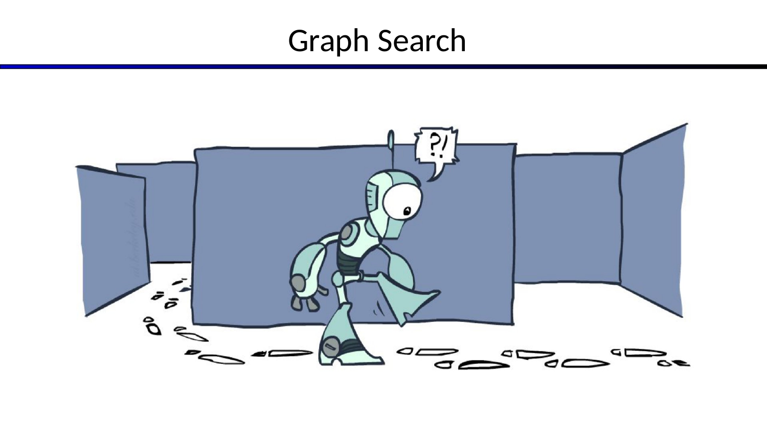
LOCAL SEARCH
Graph Search
Slide 11
COMP 469 • Artificial Intelligence • Local Search

Slide 12
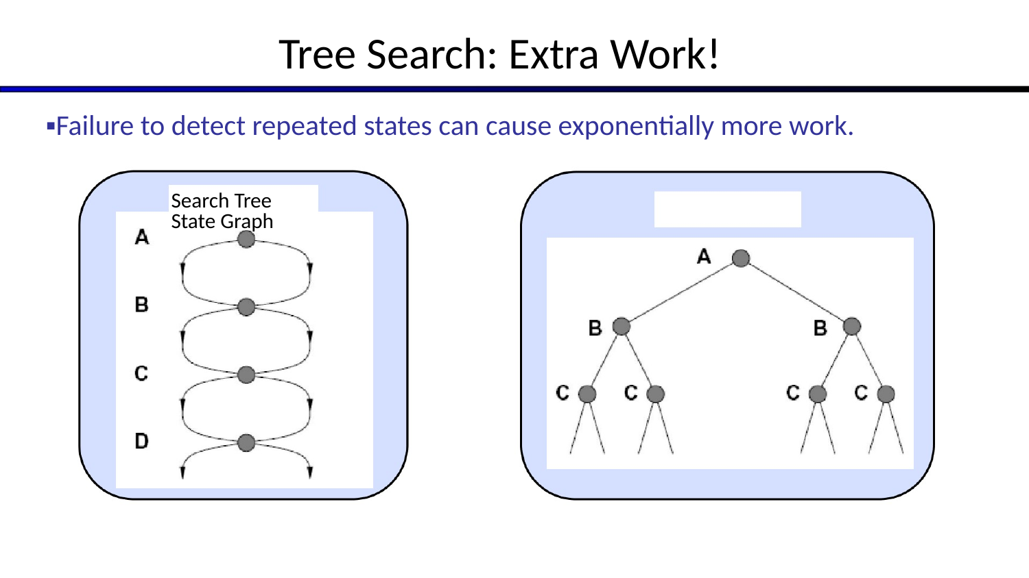
▪Failure to detect repeated states can cause exponentially more work.
12
Search Tree State Graph Tree Search: Extra Work!
COMP 469 • Artificial Intelligence • Local Search

Slide 13
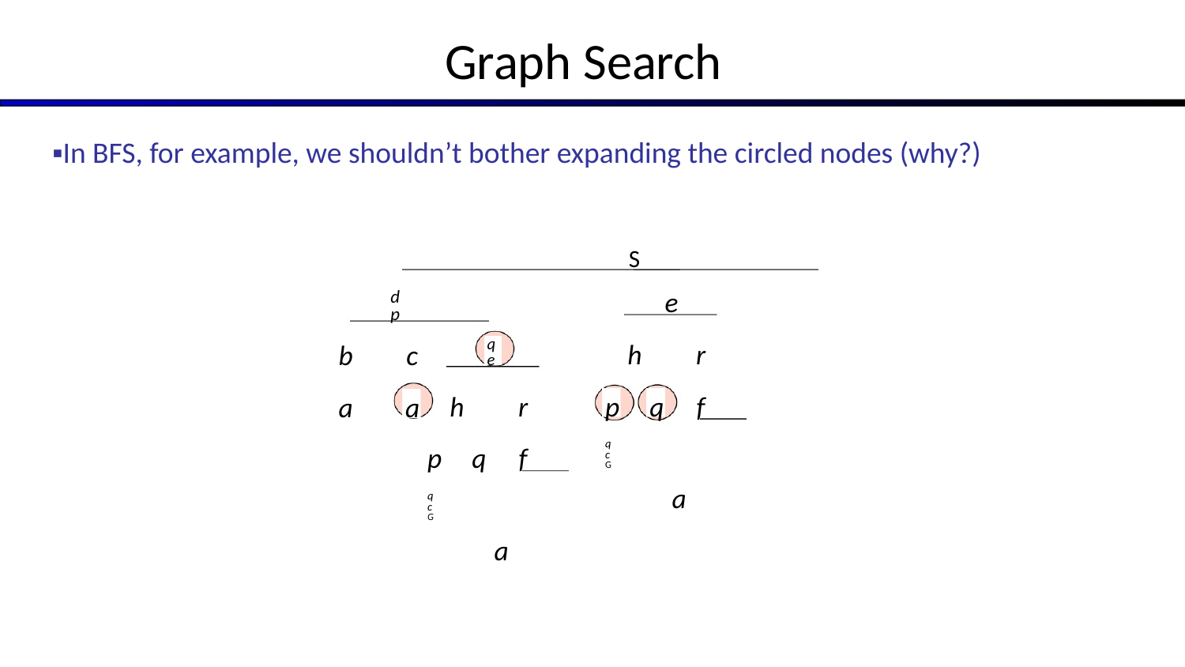
Graph Search
13
In BFS, for example, we shouldn’t bother expanding the circled nodes (why?) S a b d p a c e p h f r q c G a q e p h f r q c G a
COMP 469 • Artificial Intelligence • Local Search

Slide 14
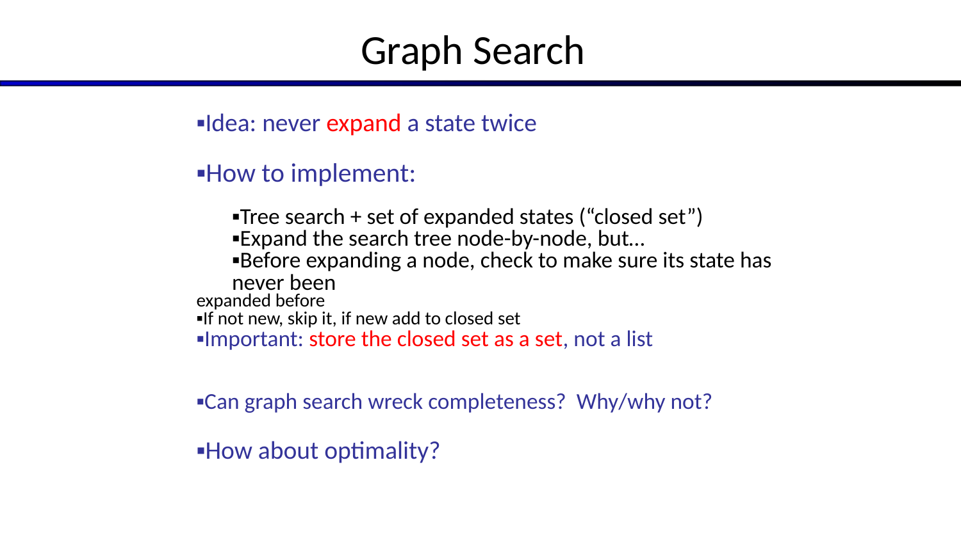
Graph Search
14
Idea: never expand a state twice
How to implement:
Tree search + set of expanded states (“closed set”)
Expand the search tree node-by-node, but…
Before expanding a node, check to make sure its state has never been expanded before
If not new, skip it, if new add to closed set
Important: store the closed set as a set, not a list
Can graph search wreck completeness? Why/why not?
How about optimality?
COMP 469 • Artificial Intelligence • Local Search

Slide 15
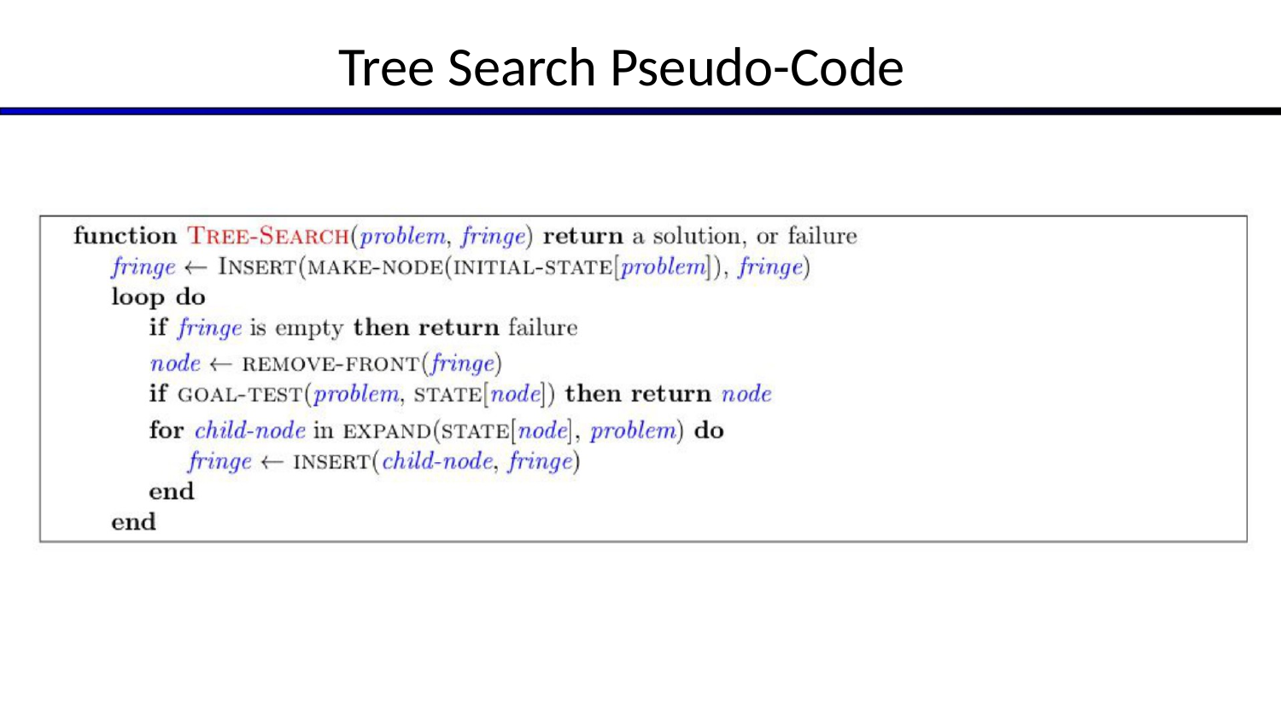
LOCAL SEARCH
Tree Search Pseudo-Code
Slide 15
COMP 469 • Artificial Intelligence • Local Search

Slide 16
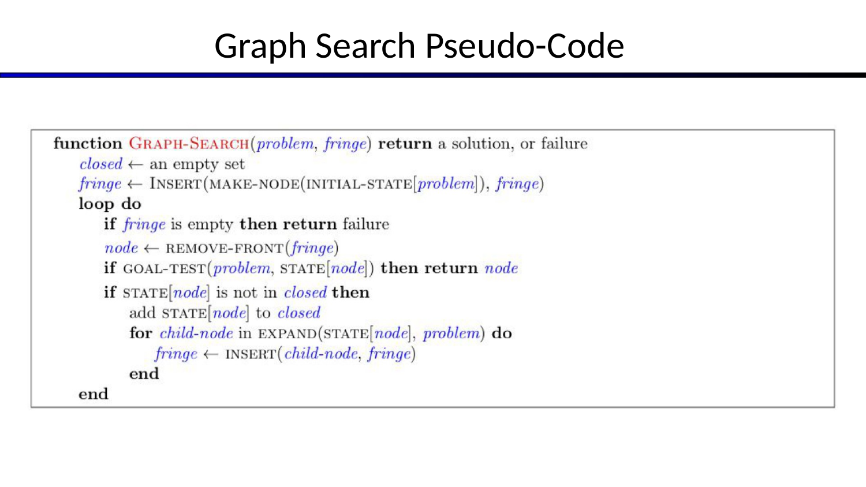
LOCAL SEARCH
Graph Search Pseudo-Code
Slide 16
COMP 469 • Artificial Intelligence • Local Search

Slide 17
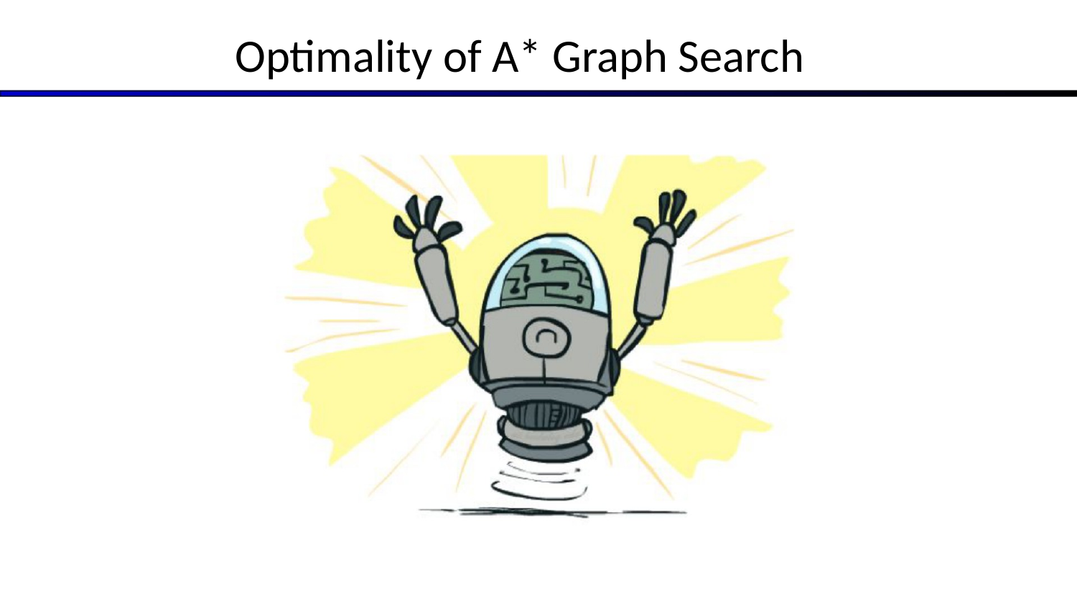
LOCAL SEARCH
Optimality of A* Graph Search
Slide 17
COMP 469 • Artificial Intelligence • Local Search

Slide 18
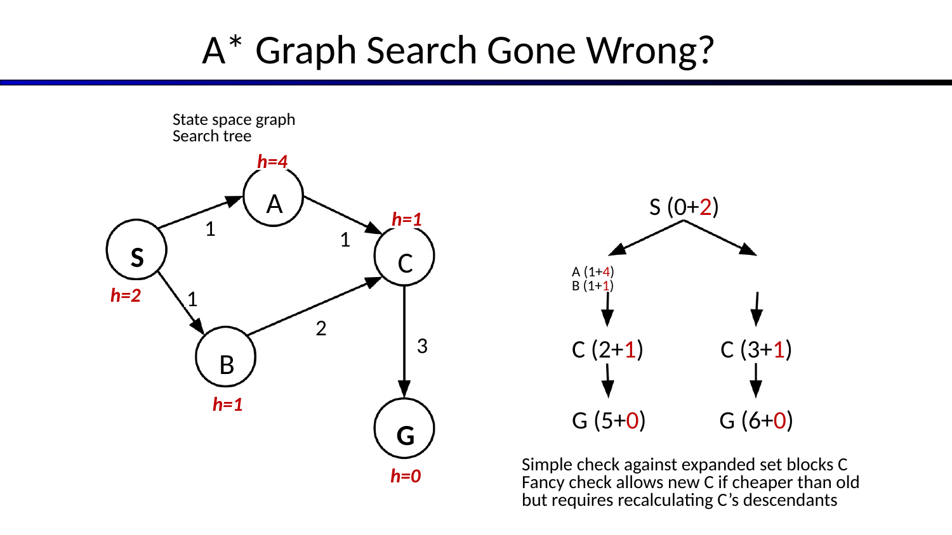
A* Graph Search Gone Wrong?
18
S A B C G h=2 h=1 h=4 h=1 h=0 S (0+2) A (1+4) B (1+1) C (2+1) G (5+0) C (3+1) G (6+0) State space graph Search tree Simple check against expanded set blocks C Fancy check allows new C if cheaper than old but requires recalculating C’s descendants
COMP 469 • Artificial Intelligence • Local Search

Slide 19
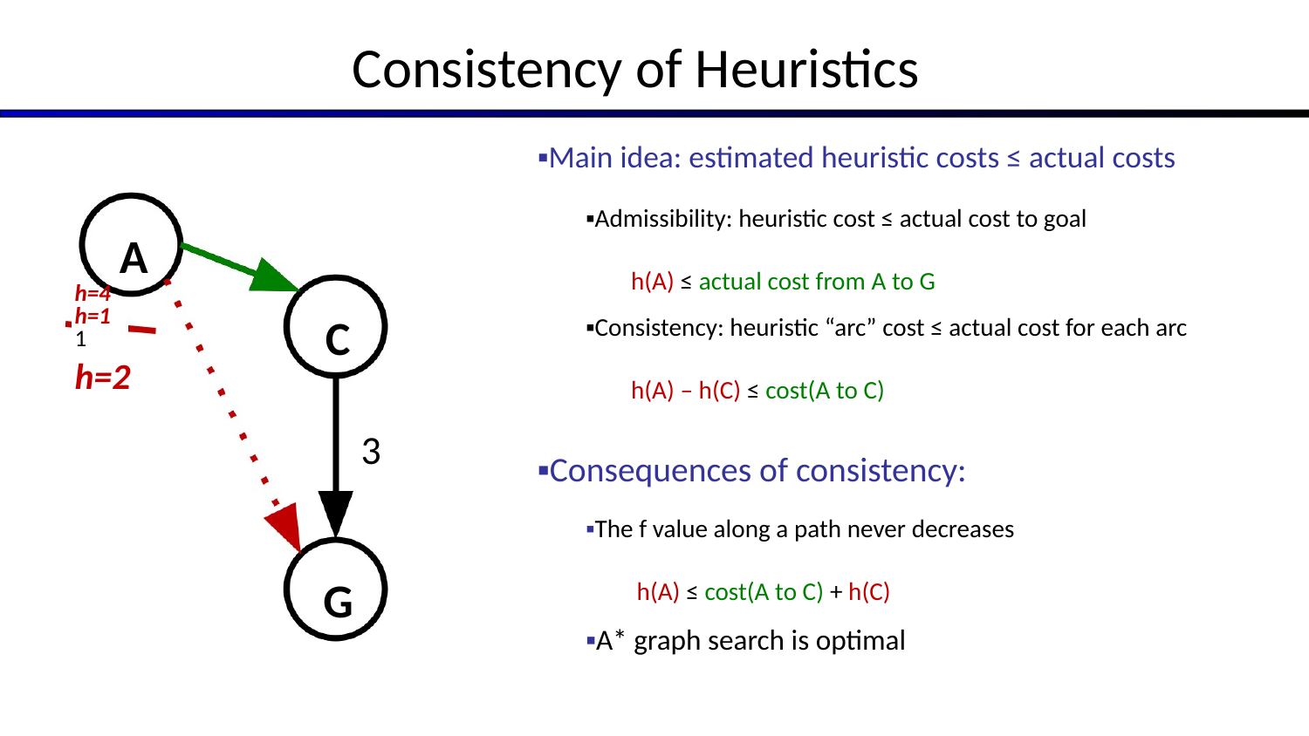
Consistency of Heuristics
19
Main idea: estimated heuristic costs ≤ actual costs
Admissibility: heuristic cost ≤ actual cost to goal h(A) ≤ actual cost from A to G
Consistency: heuristic “arc” cost ≤ actual cost for each arc h(A) – h(C) ≤ cost(A to C)
Consequences of consistency:
The f value along a path never decreases h(A) ≤ cost(A to C) + h(C)
A* graph search is optimal A C G h=4 h=1 h=2
COMP 469 • Artificial Intelligence • Local Search

Slide 20
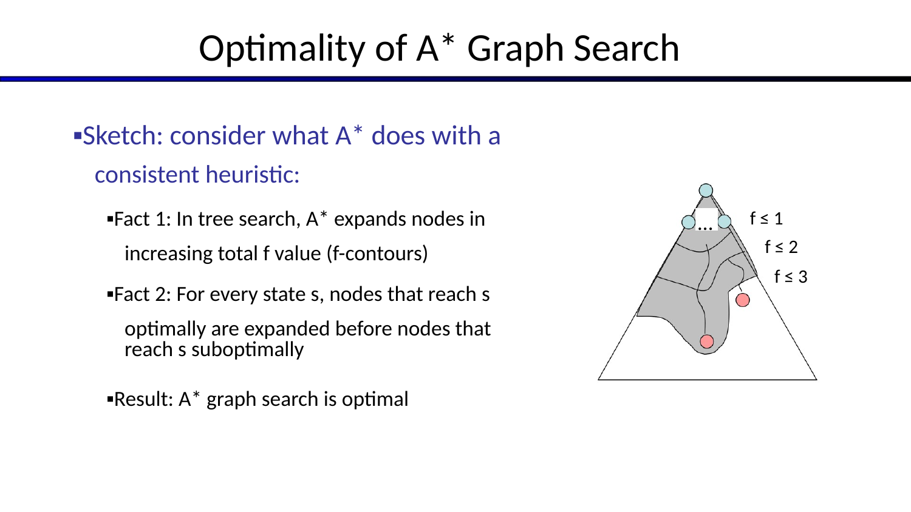
Optimality of A* Graph Search
20
Sketch: consider what A* does with a consistent heuristic:
Fact 1: In tree search, A* expands nodes in increasing total f value (f-contours)
Fact 2: For every state s, nodes that reach s optimally are expanded before nodes that reach s suboptimally
Result: A* graph search is optimal … f ≤ 3 f ≤ 2 f ≤ 1
COMP 469 • Artificial Intelligence • Local Search

Slide 21
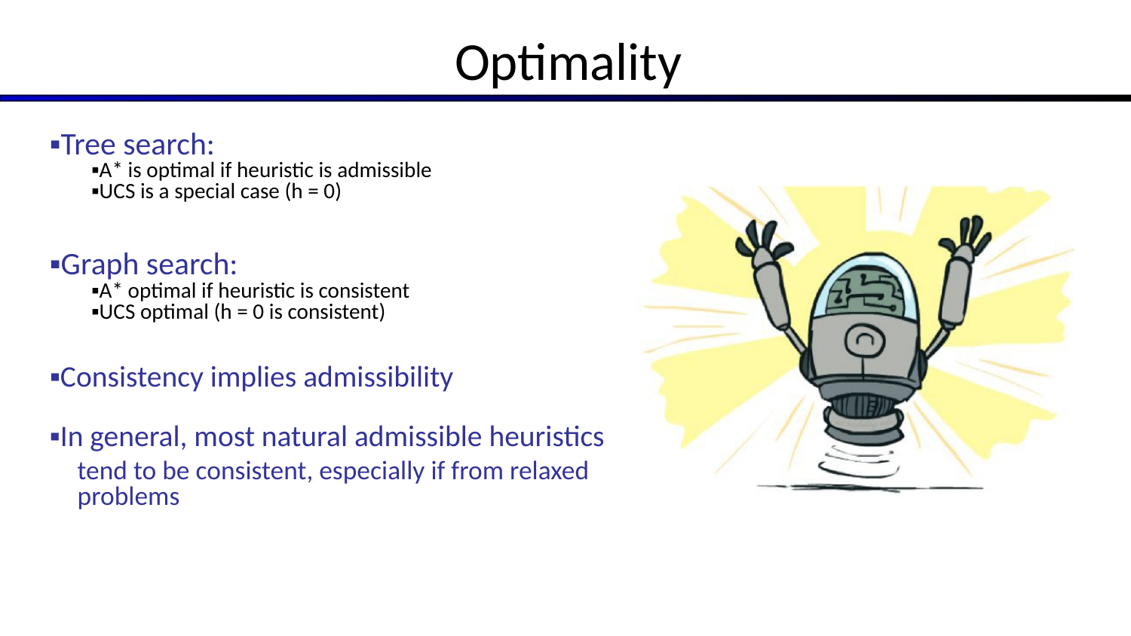
Optimality
21
Tree search:
A* is optimal if heuristic is admissible
UCS is a special case (h = 0)
Graph search:
A* optimal if heuristic is consistent
UCS optimal (h = 0 is consistent)
Consistency implies admissibility
In general, most natural admissible heuristics tend to be consistent, especially if from relaxed problems
COMP 469 • Artificial Intelligence • Local Search

Slide 22
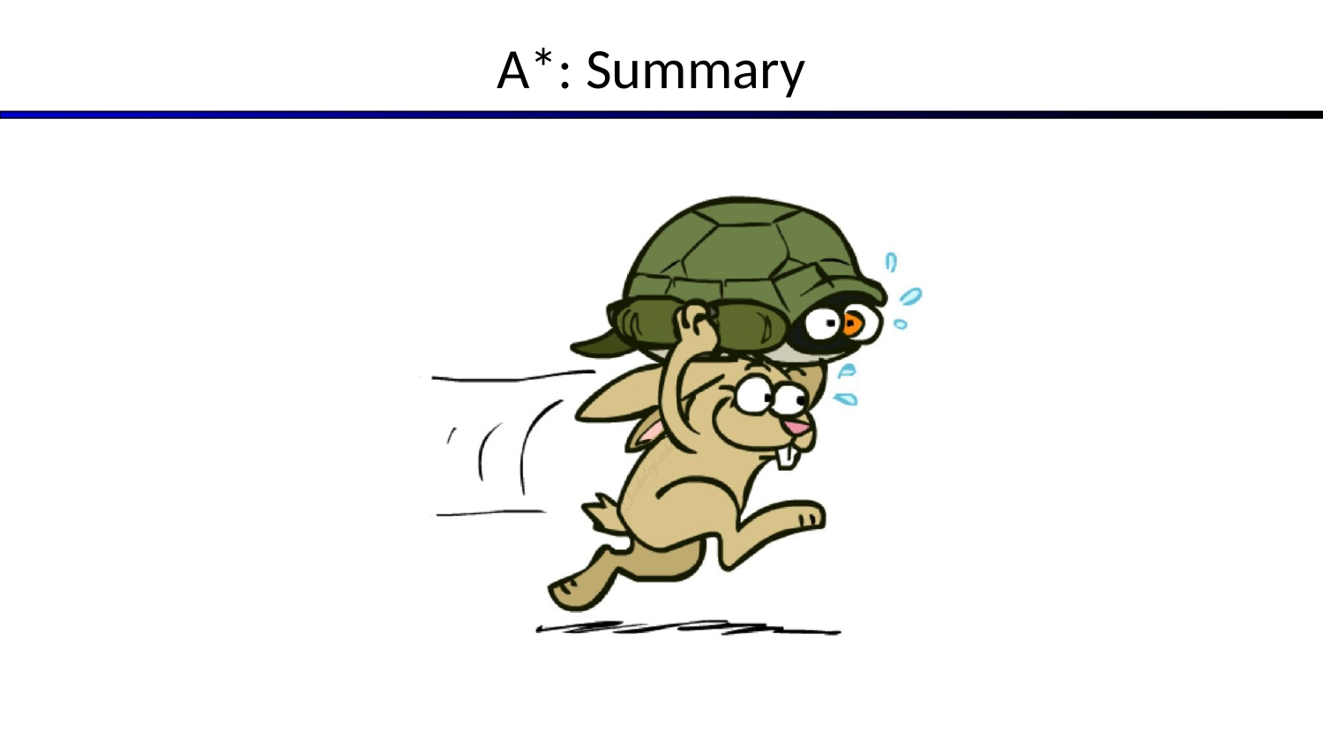
LOCAL SEARCH
A*: Summary
Slide 22
COMP 469 • Artificial Intelligence • Local Search

Slide 23
A*: Summary
23
A* uses both backward costs and (estimates of) forward costs
A* is optimal for trees/graphs with admissible / consistent heuristics
Heuristic design is key: often use relaxed problems
COMP 469 • Artificial Intelligence • Local Search

Slide 24
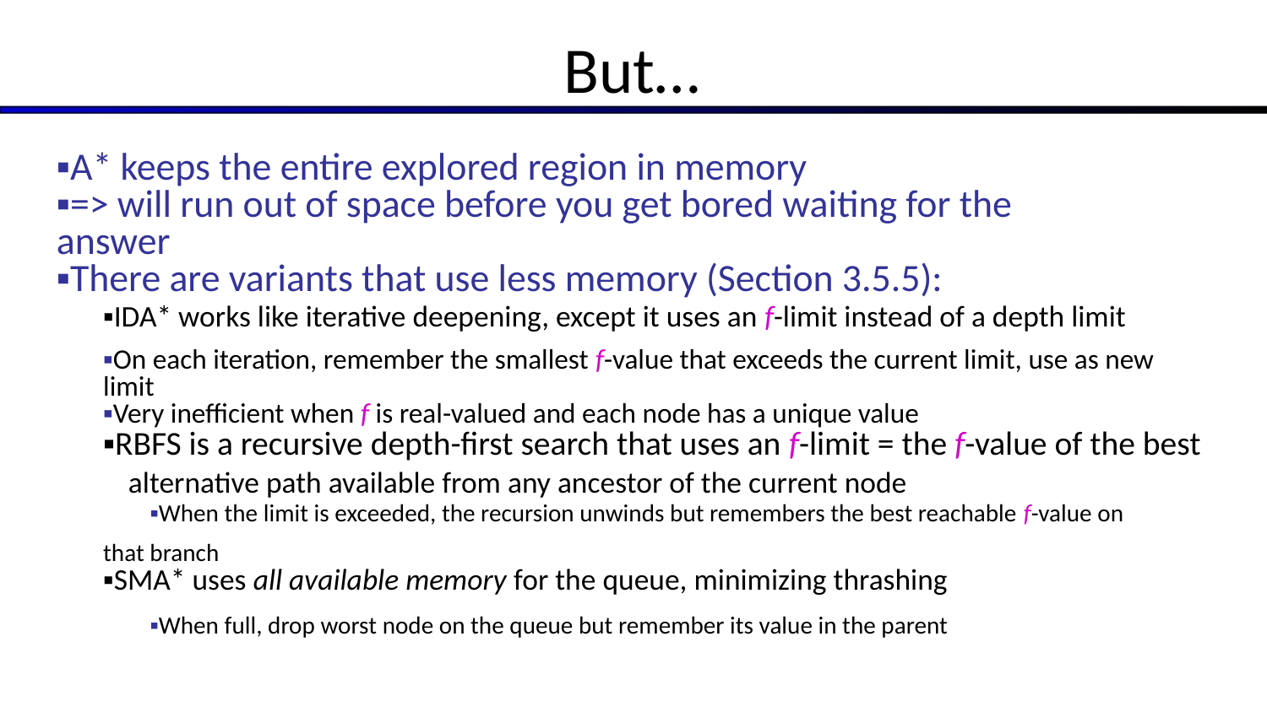
But…
24
A* keeps the entire explored region in memory
=> will run out of space before you get bored waiting for the answer
There are variants that use less memory (Section 3.5.5):
IDA* works like iterative deepening, except it uses an f-limit instead of a depth limit
On each iteration, remember the smallest f-value that exceeds the current limit, use as new limit
Very inefficient when f is real-valued and each node has a unique value
RBFS is a recursive depth-first search that uses an f-limit = the f-value of the best alternative path available from any ancestor of the current node
When the limit is exceeded, the recursion unwinds but remembers the best reachable f-value on that branch
SMA* uses all available memory for the queue, minimizing thrashing
When full, drop worst node on the queue but remember its value in the parent
COMP 469 • Artificial Intelligence • Local Search

Slide 25
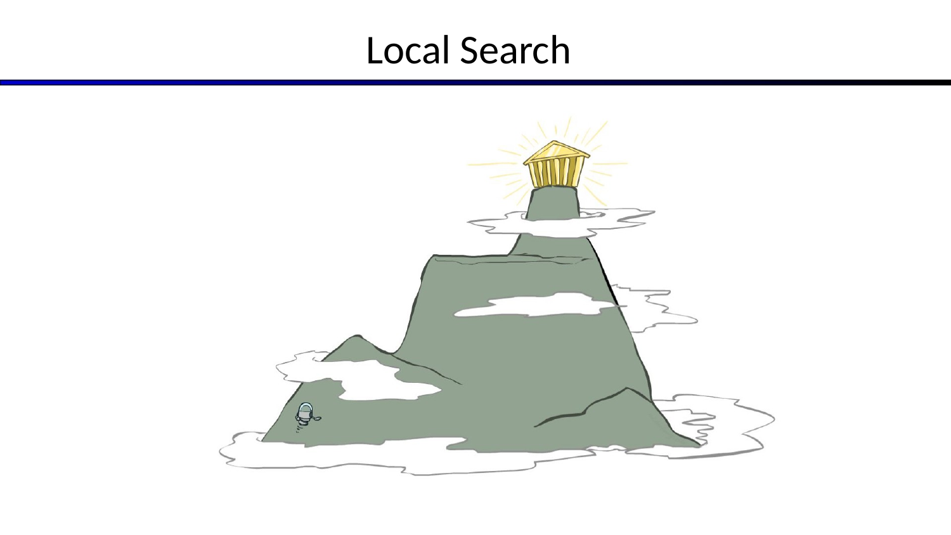
LOCAL SEARCH
Local Search
Slide 25
COMP 469 • Artificial Intelligence • Local Search

Slide 26
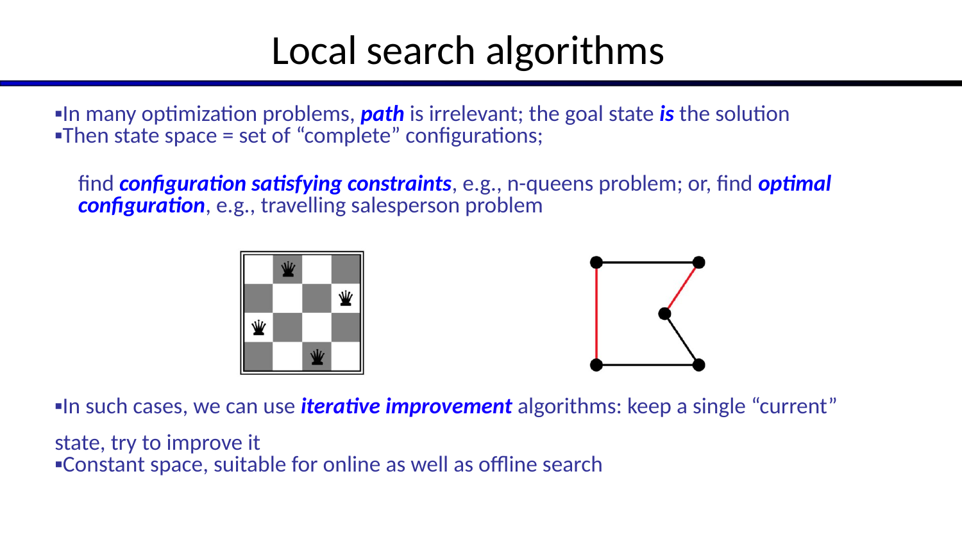
Local search algorithms
26
In many optimization problems, path is irrelevant; the goal state is the solution
Then state space = set of “complete” configurations; find configuration satisfying constraints, e.g., n-queens problem; or, find optimal configuration, e.g., travelling salesperson problem
In such cases, we can use iterative improvement algorithms: keep a single “current” state, try to improve it
Constant space, suitable for online as well as offline search
COMP 469 • Artificial Intelligence • Local Search

Slide 27
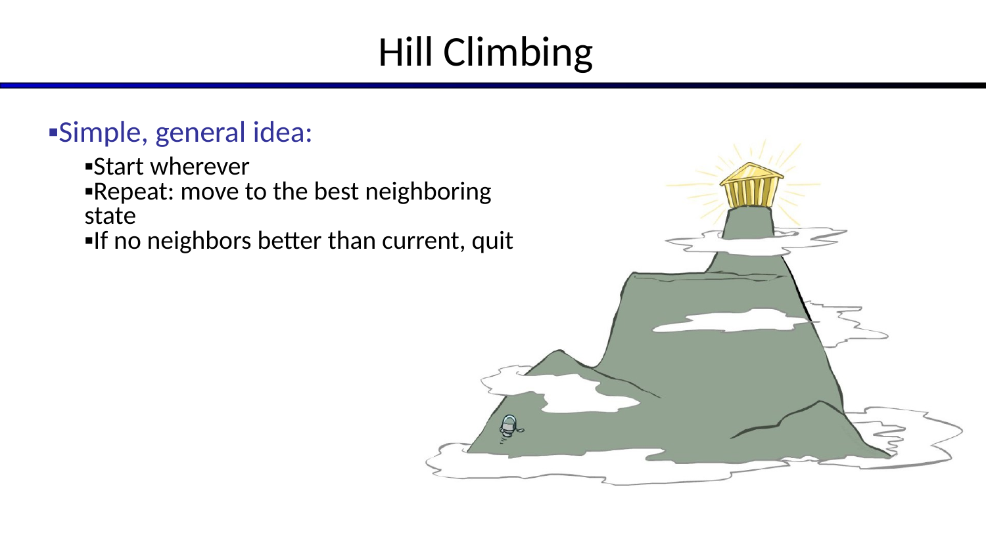
Hill Climbing
27
Simple, general idea:
Start wherever
Repeat: move to the best neighboring state
If no neighbors better than current, quit
COMP 469 • Artificial Intelligence • Local Search

Slide 28
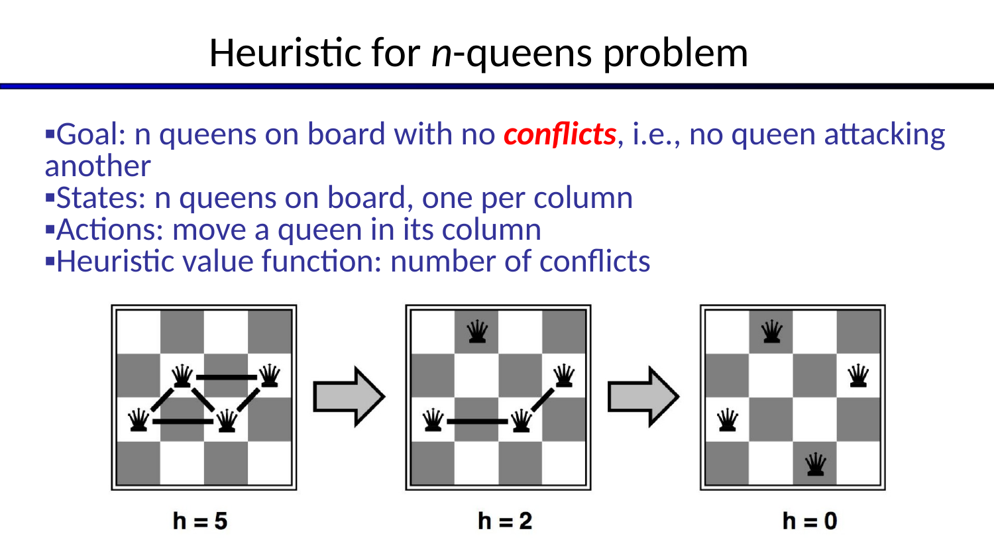
Heuristic for n-queens problem
28
Goal: n queens on board with no conflicts, i.e., no queen attacking another
States: n queens on board, one per column
Actions: move a queen in its column
Heuristic value function: number of conflicts
COMP 469 • Artificial Intelligence • Local Search

Slide 29
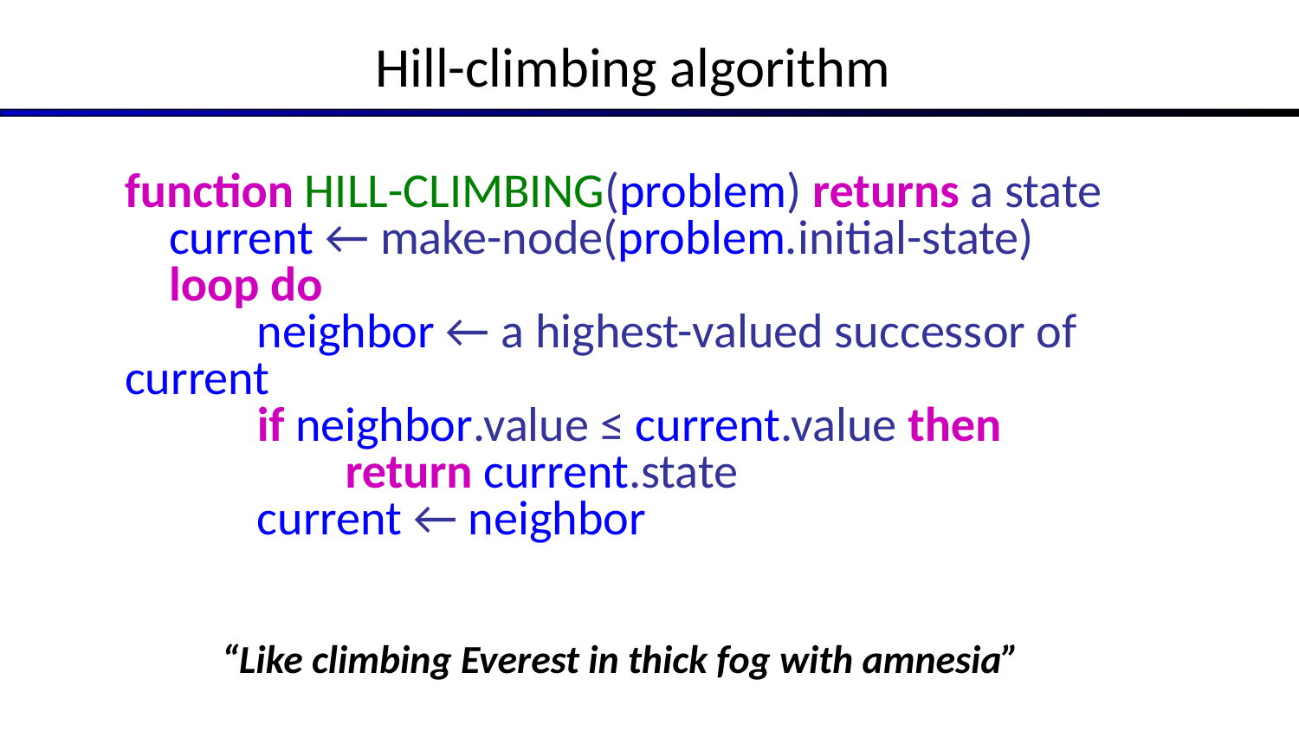
Hill-climbing algorithm
29
function HILL-CLIMBING(problem) returns a state current ← make-node(problem.initial-state) loop do neighbor ← a highest-valued successor of current if neighbor.value ≤ current.value then return current.state current ← neighbor
“Like climbing Everest in thick fog with amnesia”
COMP 469 • Artificial Intelligence • Local Search

Slide 30
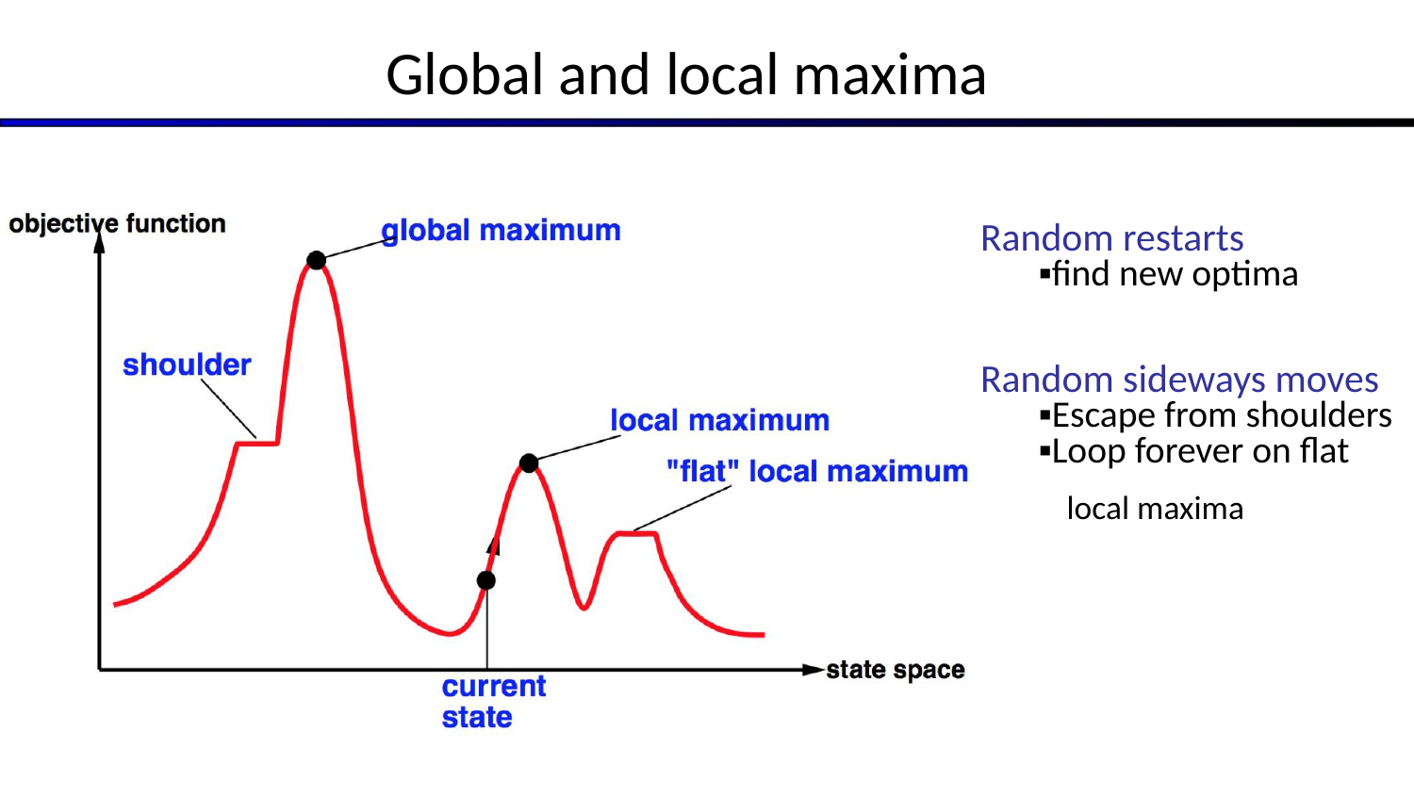
Global and local maxima
30
Random restarts
find new optima Random sideways moves
Escape from shoulders
Loop forever on flat local maxima
COMP 469 • Artificial Intelligence • Local Search

Slide 31
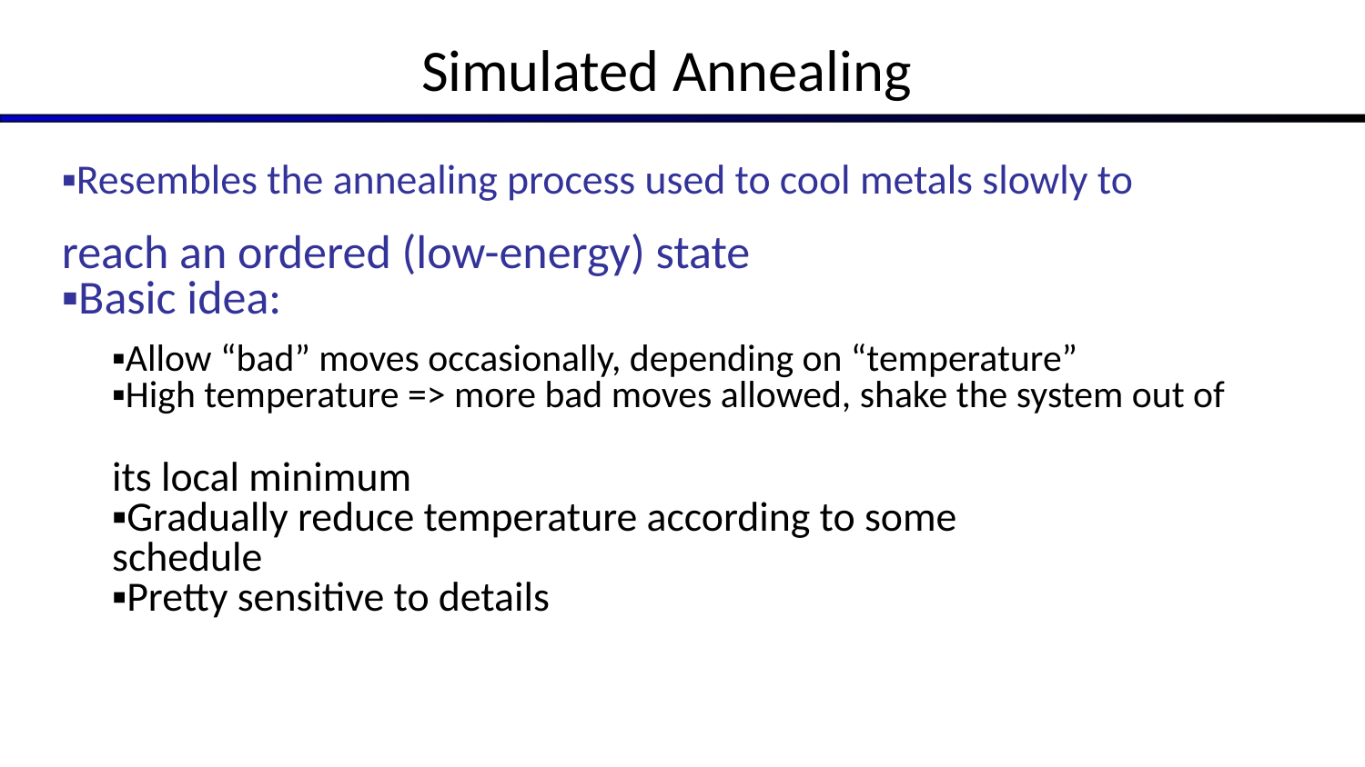
Simulated Annealing
31
Resembles the annealing process used to cool metals slowly to reach an ordered (low-energy) state
Basic idea:
Allow “bad” moves occasionally, depending on “temperature”
High temperature => more bad moves allowed, shake the system out of its local minimum
Gradually reduce temperature according to some schedule
Pretty sensitive to details
COMP 469 • Artificial Intelligence • Local Search

Slide 32
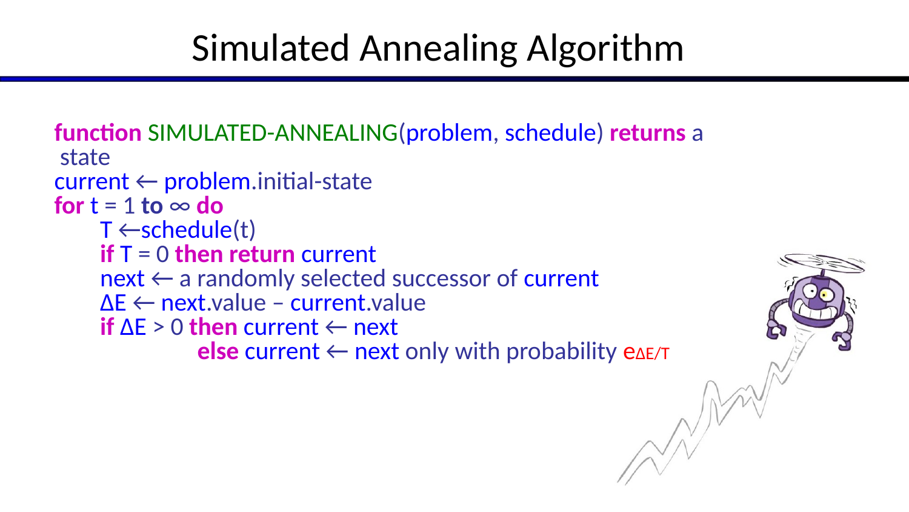
Simulated Annealing Algorithm
32
function SIMULATED-ANNEALING(problem, schedule) returns a state current ← problem.initial-state for t = 1 to ∞ do T ←schedule(t) if T = 0 then return current next ← a randomly selected successor of current ∆E ← next.value – current.value if ∆E > 0 then current ← next else current ← next only with probability e∆E/T
COMP 469 • Artificial Intelligence • Local Search

Slide 33
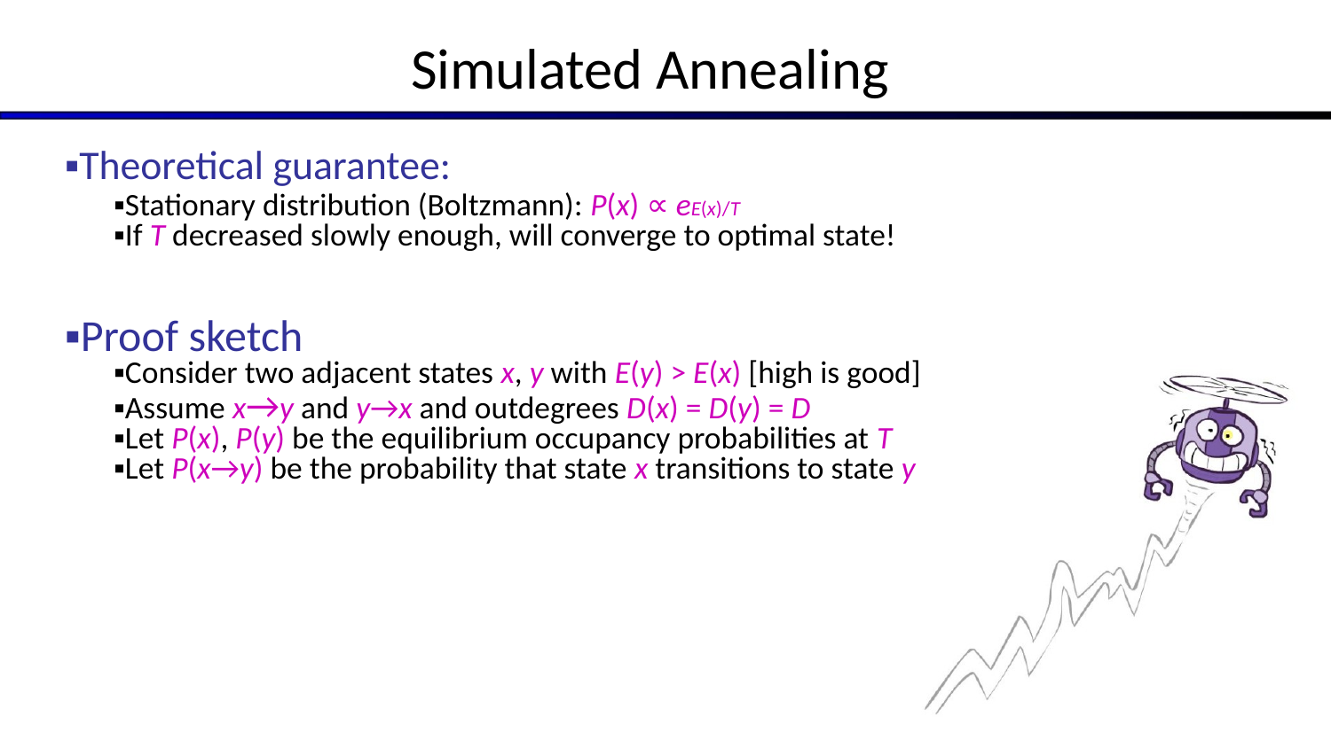
Simulated Annealing
33
Theoretical guarantee:
Stationary distribution (Boltzmann): P(x) ∝ eE(x)/T
If T decreased slowly enough, will converge to optimal state!
Proof sketch
Consider two adjacent states x, y with E(y) > E(x) [high is good]
Assume x→y and y→x and outdegrees D(x) = D(y) = D
Let P(x), P(y) be the equilibrium occupancy probabilities at T
Let P(x→y) be the probability that state x transitions to state y
COMP 469 • Artificial Intelligence • Local Search

Slide 34
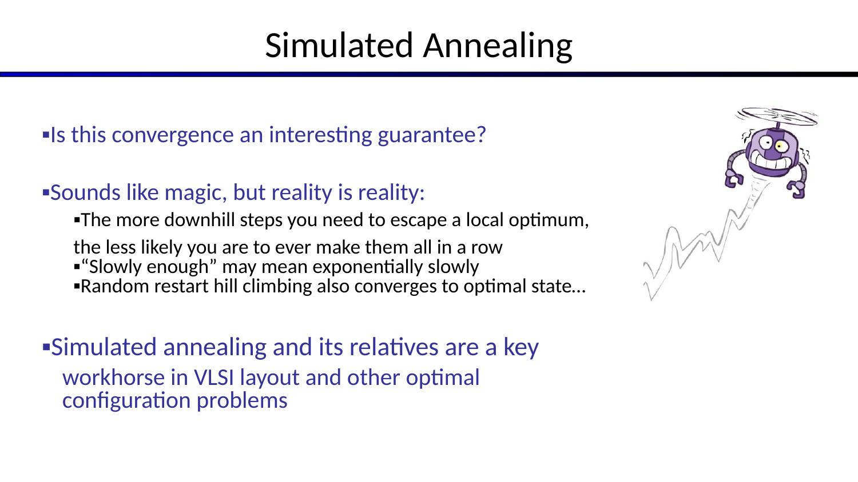
Simulated Annealing
34
Is this convergence an interesting guarantee?
Sounds like magic, but reality is reality:
The more downhill steps you need to escape a local optimum, the less likely you are to ever make them all in a row
“Slowly enough” may mean exponentially slowly
Random restart hill climbing also converges to optimal state…
Simulated annealing and its relatives are a key workhorse in VLSI layout and other optimal configuration problems
COMP 469 • Artificial Intelligence • Local Search

Slide 35
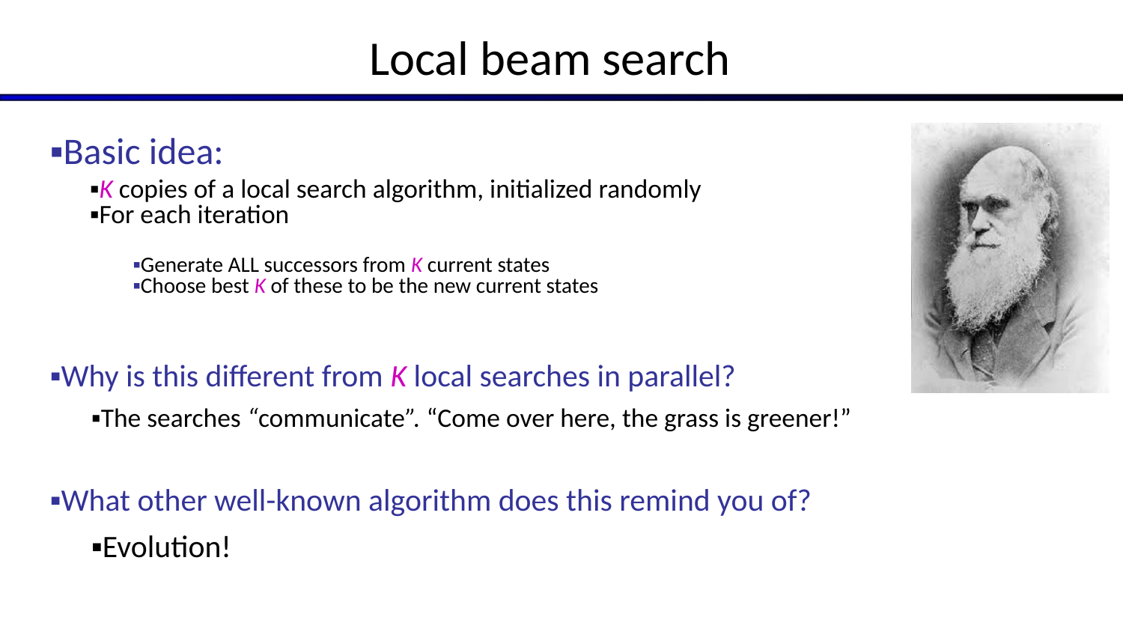
Local beam search
35
Basic idea:
K copies of a local search algorithm, initialized randomly
For each iteration
Generate ALL successors from K current states
Choose best K of these to be the new current states
Why is this different from K local searches in parallel?
The searches “communicate”. “Come over here, the grass is greener!”
What other well-known algorithm does this remind you of?
Evolution!
COMP 469 • Artificial Intelligence • Local Search

Slide 36
Genetic algorithms
36
Genetic algorithms use a natural selection metaphor
Resample K individuals at each step (selection) weighted by fitness function
Combine by pairwise crossover operators, plus mutation to give variety
COMP 469 • Artificial Intelligence • Local Search

Slide 37
Example: N-Queens
37
Does crossover make sense here?
What would mutation be?
What would a good fitness function be?
COMP 469 • Artificial Intelligence • Local Search

Slide 38
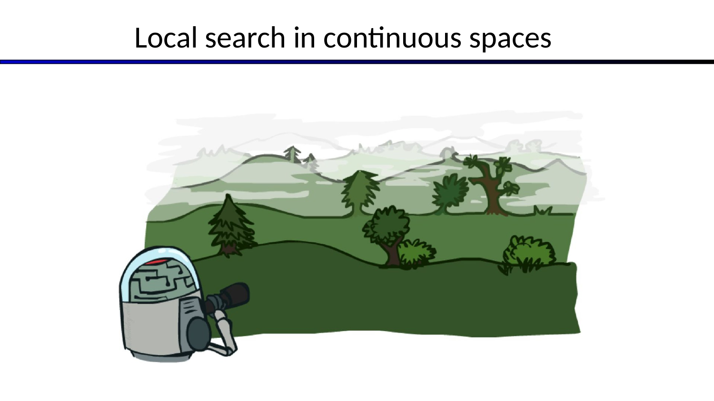
LOCAL SEARCH
Local search in continuous spaces
Slide 38
COMP 469 • Artificial Intelligence • Local Search

Slide 39
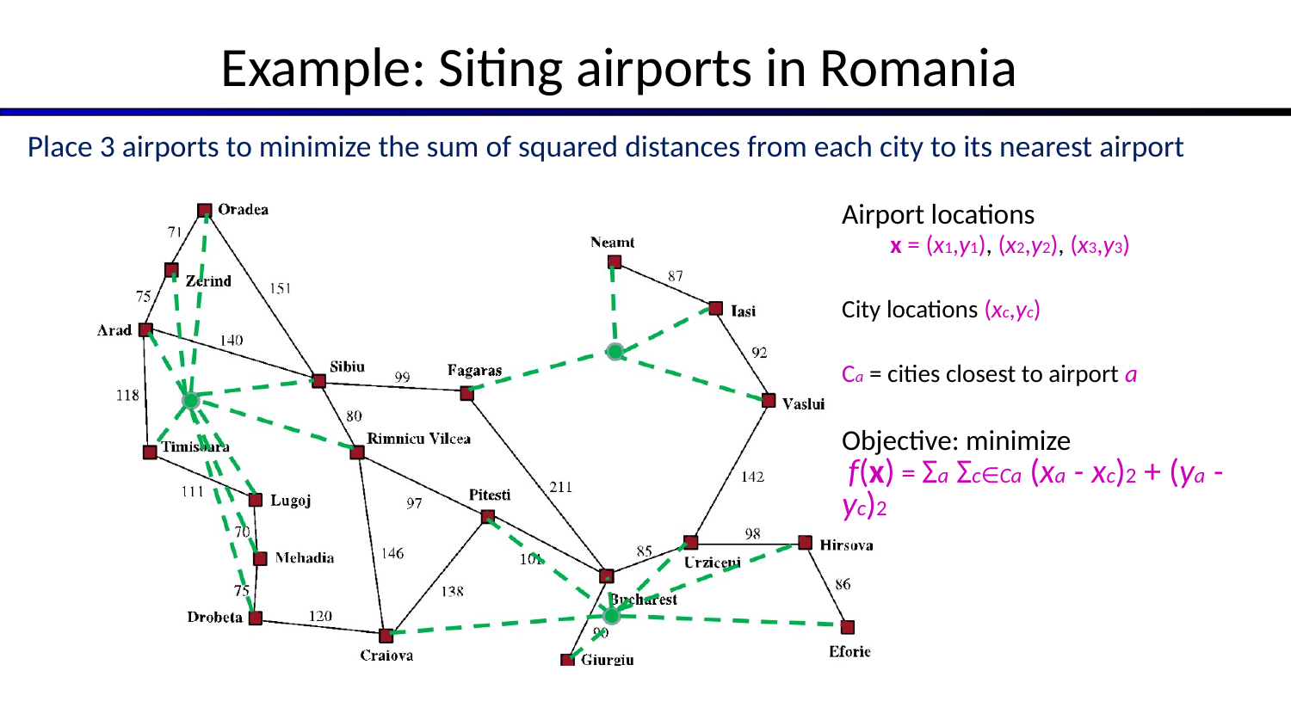
Example: Siting airports in Romania
39
Place 3 airports to minimize the sum of squared distances from each city to its nearest airport Airport locations x = (x1,y1), (x2,y2), (x3,y3) City locations (xc,yc) Ca = cities closest to airport a Objective: minimize f(x) = Σa Σc∈Ca (xa - xc)2 + (ya - yc)2
COMP 469 • Artificial Intelligence • Local Search

Slide 40
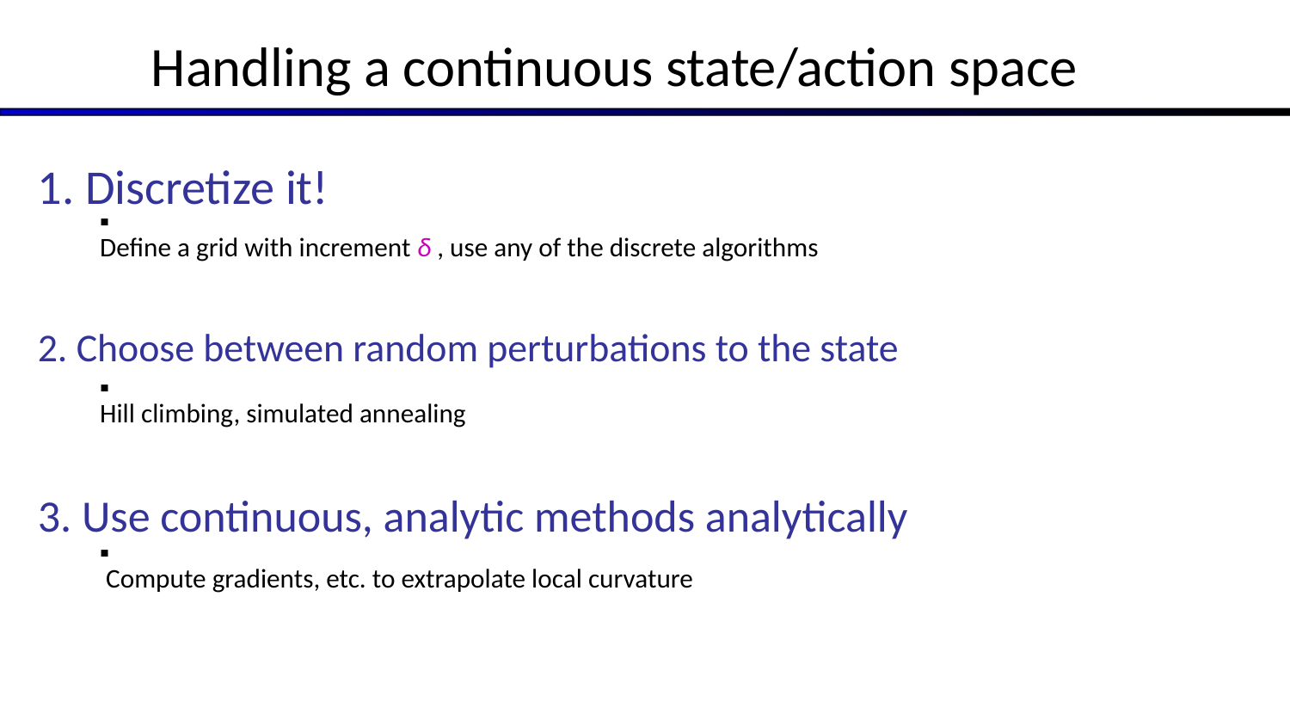
Handling a continuous state/action space
40
1. Discretize it!
Define a grid with increment δ , use any of the discrete algorithms
2. Choose between random perturbations to the state
Hill climbing, simulated annealing
3. Use continuous, analytic methods analytically
Compute gradients, etc. to extrapolate local curvature
COMP 469 • Artificial Intelligence • Local Search

Slide 41
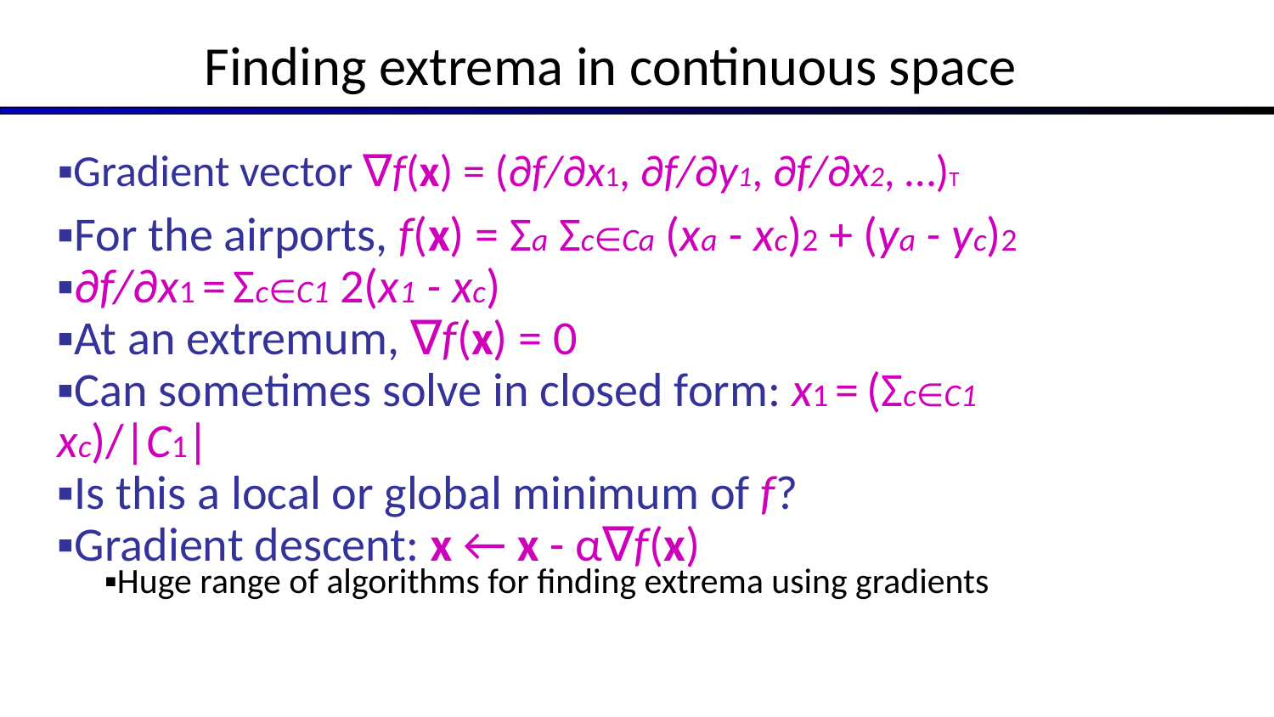
Finding extrema in continuous space
41
Gradient vector ∇f(x) = (∂f/∂x1, ∂f/∂y1, ∂f/∂x2, …)T
For the airports, f(x) = Σa Σc∈Ca (xa - xc)2 + (ya - yc)2
∂f/∂x1 = Σc∈C1 2(x1 - xc)
At an extremum, ∇f(x) = 0
Can sometimes solve in closed form: x1 = (Σc∈C1 xc)/|C1|
Is this a local or global minimum of f?
Gradient descent: x ← x - α∇f(x)
Huge range of algorithms for finding extrema using gradients
COMP 469 • Artificial Intelligence • Local Search

Slide 42
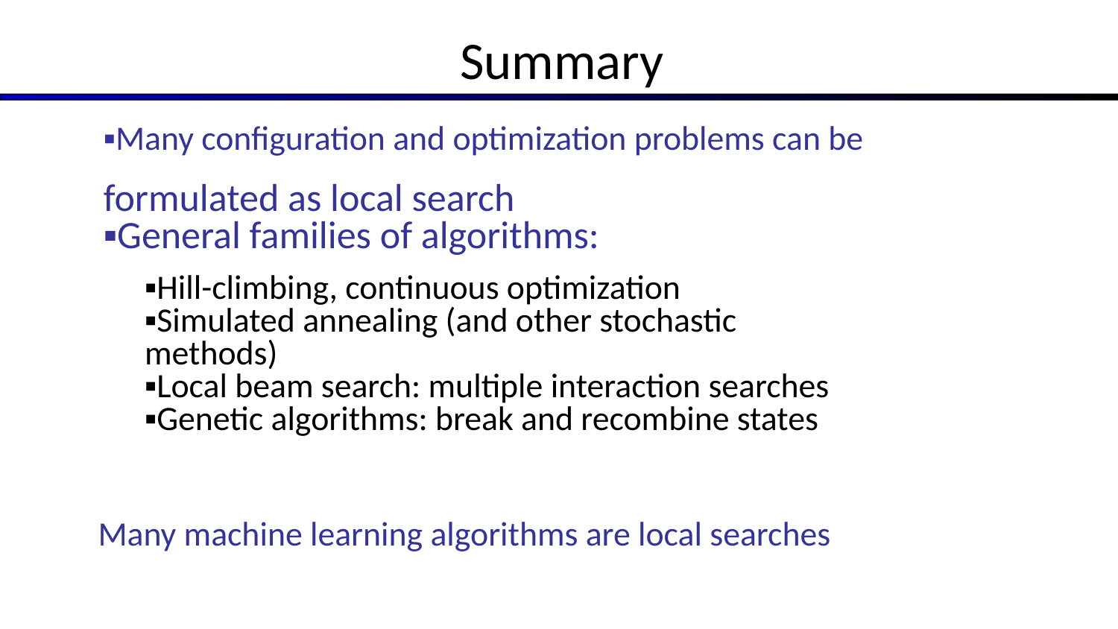
Summary
42
Many configuration and optimization problems can be
formulated as local search
General families of algorithms:
Hill-climbing, continuous optimization
Simulated annealing (and other stochastic methods)
Local beam search: multiple interaction searches
Genetic algorithms: break and recombine states
Many machine learning algorithms are local searches
COMP 469 • Artificial Intelligence • Local Search

